Slide 1
Module 3

Slide 2
Arrays 1D
Arrays are used to store multiple values in a single variable, instead of declaring separate variables for each value.
An array is a group of contiguous or related data items that share a common name.
To declare an array, define the variable type with square brackets:
int a[];
The elements in the array allocated by new will automatically be initialized to zero (for numeric types), false (for boolean), or null (for reference types).

Slide 3
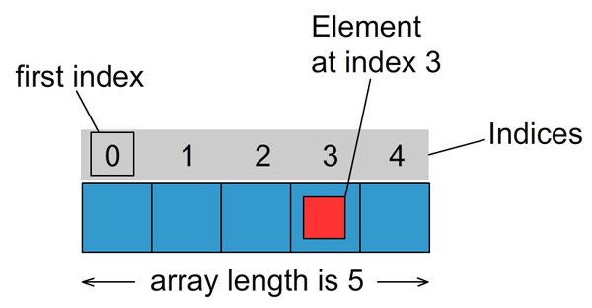
Arrays
int a[];
int a[]= {12,7,6,9,4};

Slide 4
Arrays
Creating an Array:
Declaring the array.
type arrayname[];
or
type[] arrayname;
Creating memory locations
arrayname=new type[size];
e.g. int a[]=new int[5];
int a[]=new int[n];
Putting values into the memory locations
arrayname[subscript]=value;

Slide 5
Arrays
Access the Elements of an Array:
You access an array element by referring to the index number.
String[] cars = {"Volvo", "BMW", "Ford", "Mazda"}; System.out.println(cars[0]);
Change an Array Element:
To change the value of a specific element, refer to the index number:
String[] cars = {"Volvo", "BMW", "Ford", "Mazda"}; cars[0] = "Opel"; System.out.println(cars[0]);

Slide 6
Arrays
Array Length:
To find out how many elements an array has, use the length property:
String[] cars = {"Volvo", "BMW", "Ford", "Mazda"}; System.out.println(cars.length);
Loop Through an Array
You can loop through the array elements with the for loop, and use the length property to specify how many times the loop should run.
String[] cars = {"Volvo", "BMW", "Ford", "Mazda"}; for (int i = 0; i < cars.length; i++) { System.out.println(cars[i]); }

Slide 7
Arrays
Loop Through an Array with For-Each:
There is also a "for-each" loop, which is used exclusively to loop through elements in arrays:
for (type variable : arrayname) { ... }
String[] cars = {"Volvo", "BMW", "Ford", "Mazda"}; for (String i : cars)
{ System.out.println(i); }

Slide 8
Arrays
Program to find median of an array of numbers.

Slide 9
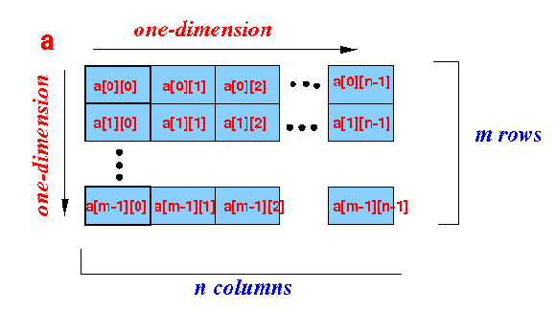
2D-Arrays
In 2D array we have rows and columns.
int a[][]= new int [m][n];

Slide 10
2D arrays
Program for addition of two matrices.
Program for multiplication of two matrices.

Slide 11
Variable size arrays/Jagged array
Variable length columns:
int x[][]=new int[n][ ];
x[0]= new int[7];
x[1]= new int[2];
x[2]= new int[5];
.
.
x[n-1]=new int[3];

Slide 12
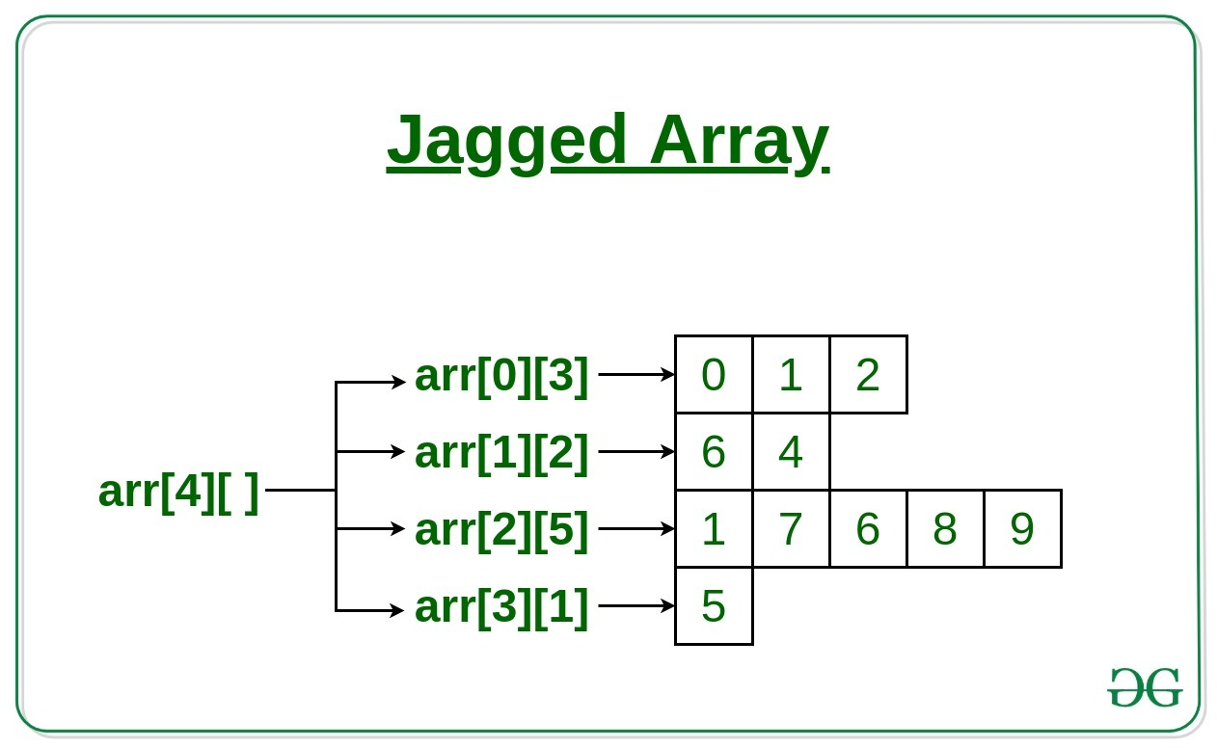
Variable size arrays/Jagged array
Variable length columns:

Slide 13
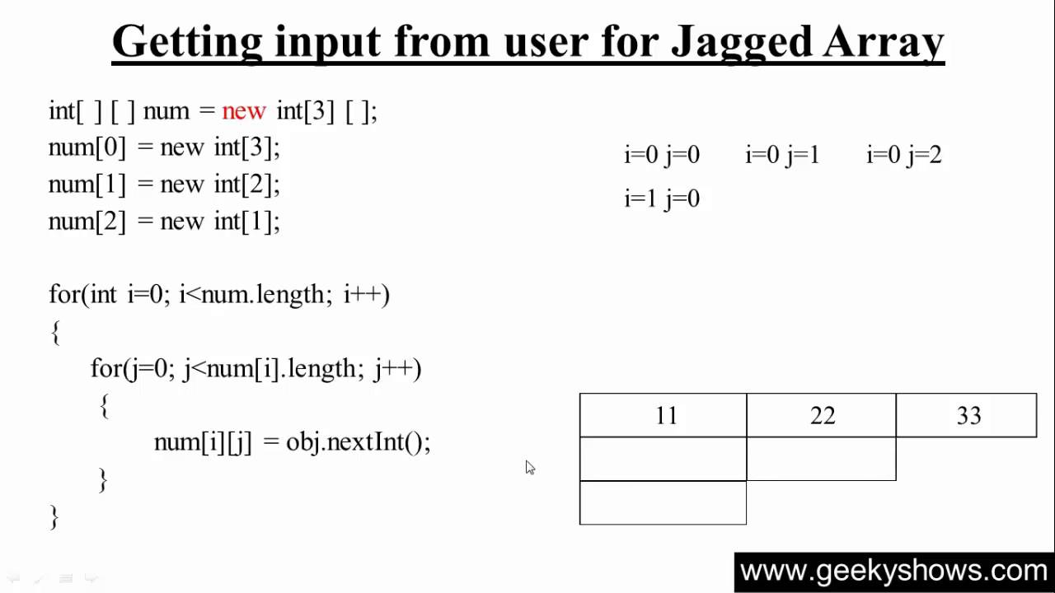
Variable size arrays/Jagged array
Variable length columns:

Slide 14
Variable size arrays/Jagged array
Write a program which stores information about n students in a two dimensional array. The array should contain number of rows equal to number of students. Each row will have number of columns equal to number of semesters by that student which
may vary from student to student. The program should display student number (index +1),percentage scored by that student in each semester and its average percentage as output. (It is expected to assign columns to each row dynamically after getting no of semesters value from user)

Slide 15
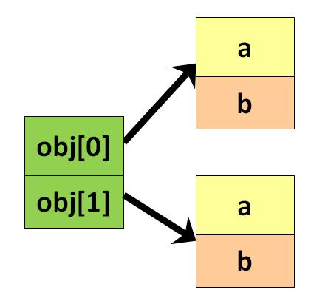
An Array of objects
Unlike traditional array which store values like string, integer, Boolean, etc. array of objects stores objects.
The array elements store the location of reference variables of the object.

Slide 16
An Array of objects
You can declare and instantiate the array of objects as shown below:
syntax: Class obj[]= new Class[array_length];
Employee emp[] = new Employee[2];
2. Once an array of objects is instantiated like above, the individual elements of the array of objects need to be created using new.
One way to initialize the array of objects is by using the constructors.
When you create actual objects, you can assign initial values to each of the objects by passing values to the constructor.
You can also have a separate member method in a class that will assign data to the objects.

Slide 17
An Array of objects
class Main
{ public static void main(String args[])
{
Employee[] obj = new Employee[2] ;
obj[0] = new Employee(100,"ABC");
obj[1] = new Employee(200,"XYZ");
System.out.println("Employee Object 1:");
obj[0].showData();
System.out.println("Employee Object 2:");
obj[1].showData();
} }
class Employee
{
int empId; String name;
Employee(int eid, String n)
{
empId = eid; name = n; }
public void showData()
{
System.out.println("EmpId = "+empId + " " + " Employee Name = "+name); } }

Slide 18
An Array of objects
Problem Statement:
Write a program which accepts information about n no of students from user
.Create an array of objects to store stud_id ,name,avg_marks.
Your program should provide following functionalities
1.To add student
2.To delete any student detail
3. To display student details.

